Slide 1

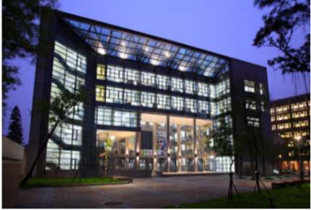

以非週期性晶疇極化反轉鈮酸鋰達成連續式或主動式Q-調制雙波長Nd:YVO₄雷射電光選頻之研究 Electro-optically laser line switchable in a dual-wavelength cw/Q-switched Nd:YVO₄ laser based on aperiodically poled lithium niobate
呂其孟
Chi Meng Lu
指導教授：陳彥宏 博士
Nonlinear Integrated Laser Photonics (NILP),
Department of Optics and Photonics,
National Central University, Jhongli 320, Taiwan

Slide 2
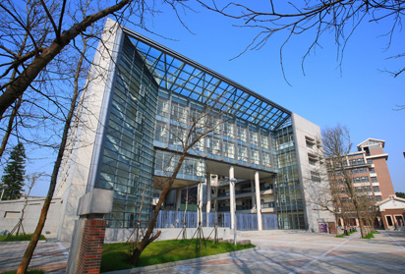
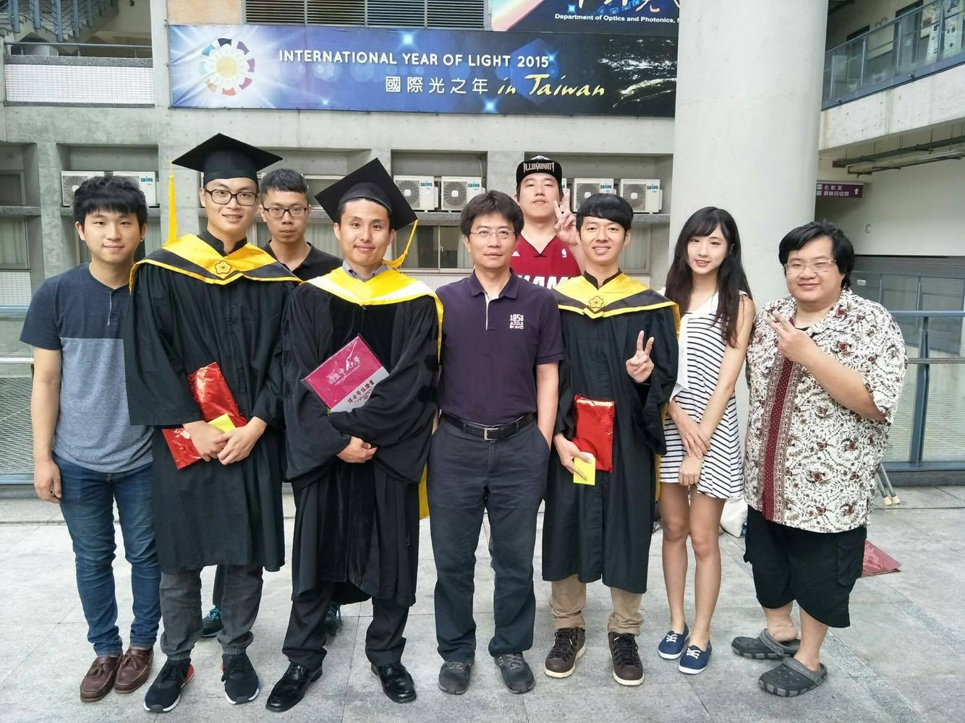

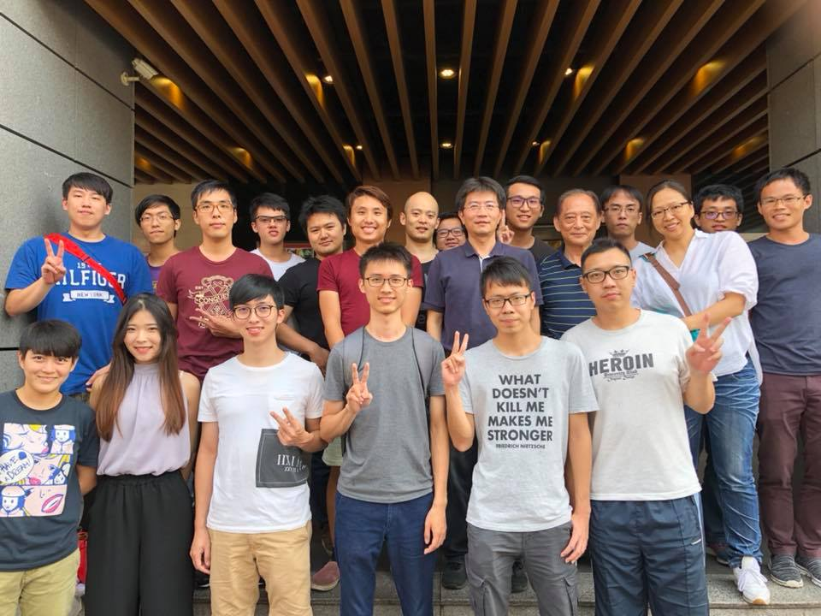

Outline
Introduction
Motivation
Objective
Working principles
Gain medium：${Nd:YVO}_{4}$
Electro-Optic Effect
Q-switching
SFG
Device Design and Simulation Results
Simulated Annealing Method
Dual-wavelength Electro-Optic polarization rotation
Simulation Results
Device Fabrication
Fabrication process of EO APPLN
Experimental Setup and Results Analysis
Single pass measurement
CW operation
Q-switched operation
Conclusions and Future work

Slide 3
Outline
Introduction
Motivation
Objective

Slide 4
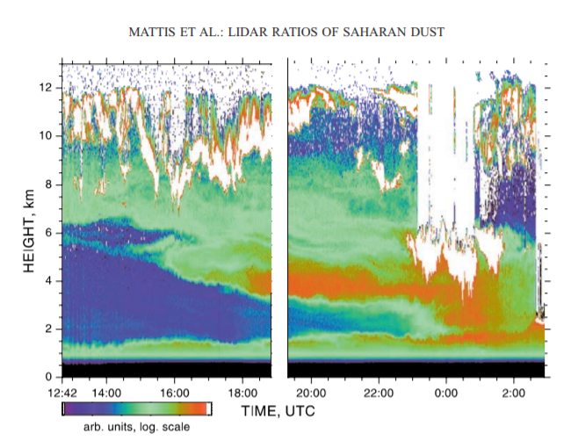
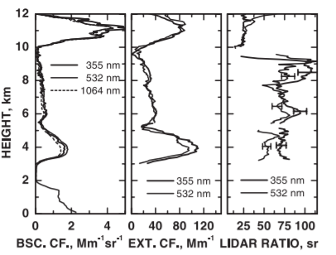


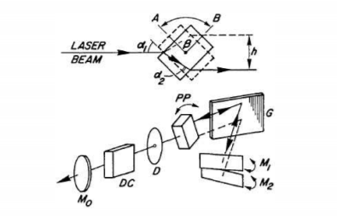
Motivation
Applications
Dual-wavelength Raman lidar
Biomedical Technology using coherent yellow/orange sources
Tunable alternate Dual-wavelength for differential absorption lidar (DIAL) systems
http://picosure.line88.tw/2018/
http://www.belovedorange.com/
Mattis, Ina, et al. Geophysical Research Letters 29.9, P.20-1 (2002)
Dai Hung, Nguyen, and P. Brechignac. Applied optics 27.10, P.1906-1908 (1988)
Notes:
1.本實驗可用於雷達技術，雷達技術可被用於測量大氣中的氣態汙染物、氣象參數或化學物種…等等，而本實驗可被作為一個可分別選擇雙波長或不同單一波長的雷達接收器或發射器。
2.橘黃光雷射在生醫、天文觀測、軍事…等受到廣泛的應用，以生醫為例，血紅素對於橘黃光的波段光源有著高度的吸收，可利於外科手術的應用。

Slide 5
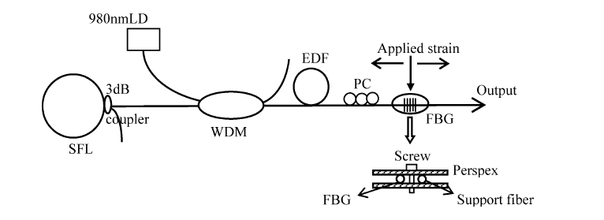
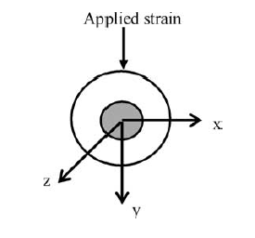
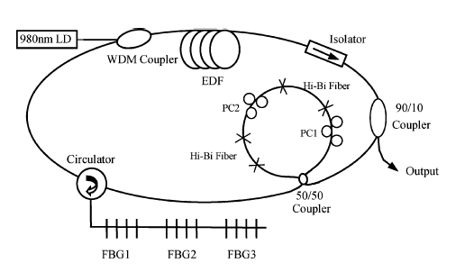
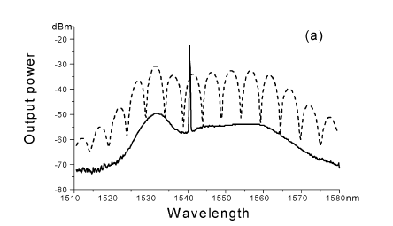
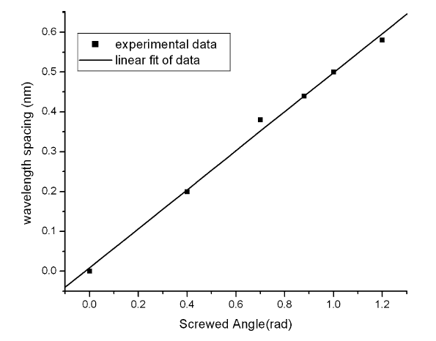
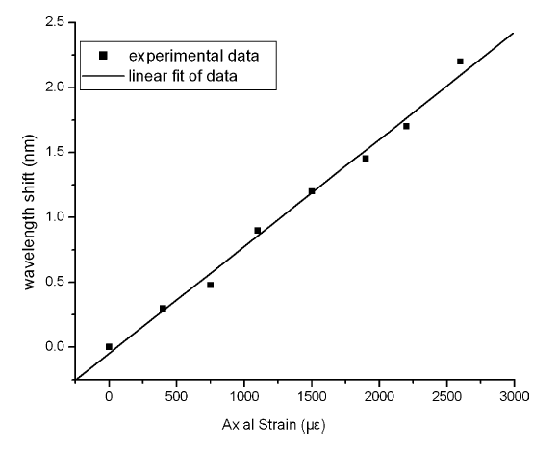
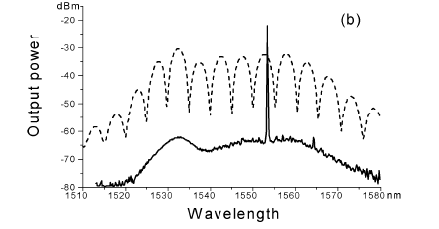
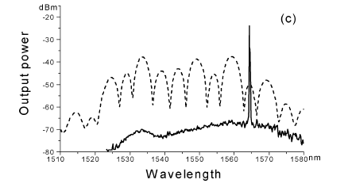
Motivation
CW Lasers
Switchable and tunable dual-wavelength erbium-doped fiber laser based on one fiber Bragg grating
Switchable Multiwavelength Erbium-Doped Fiber Ring Laser With a Multisection High-Birefringence Fiber Loop Mirror
Feng, Xinhuan, et al. Optical Fiber Technology 10.3, P.275-282 (2004)
Hu, S., et al. IEEE photonics technology letters 17.7, P.1387-1389, (2005)
Notes:
1.摻鉺光纖通過單光纖布拉格光柵（FBG），並用單光纖布拉格光柵（FBG）進行橫向應變引起兩個波長之間的間隔，並通過調整偏振控制器（PC）讓雷射可以在兩個波長之間切換
2.摻鉺光纖通過三個不同的FBG得到三個波段的光源，通過高雙折射光纖環鏡並搭配兩個偏振控制器來實現三波長隨機組合切換

Slide 6
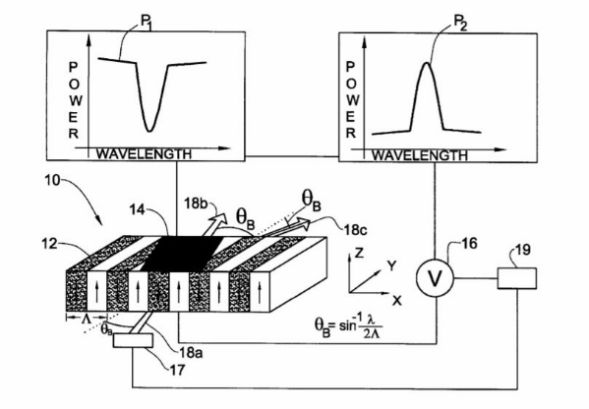
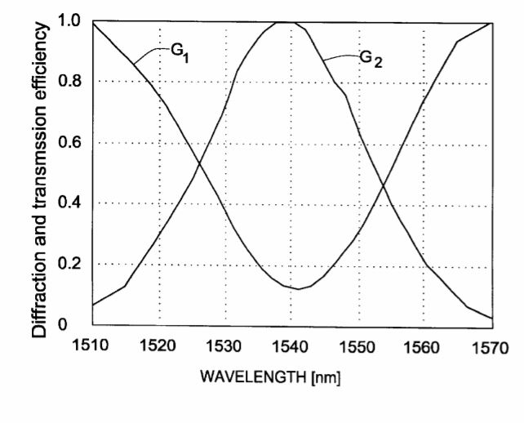
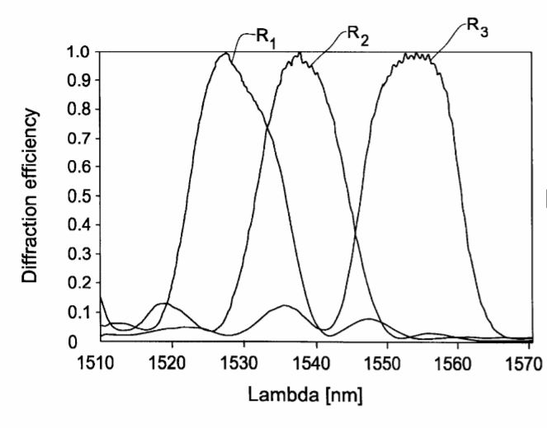
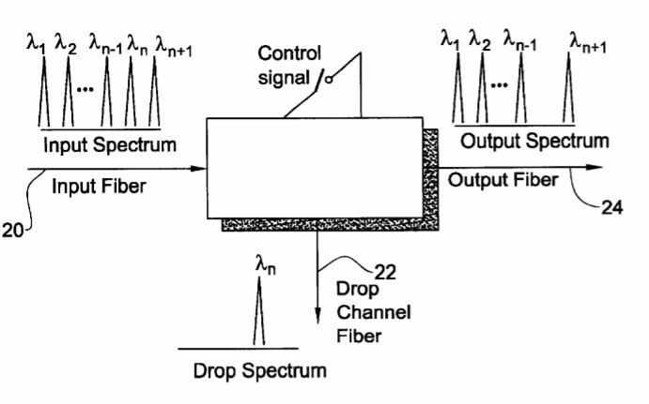
Motivation
CW Lasers
Electro-optic Bragg device and a wavelength selection method utilizing the same
Arie, Ady, and Amir Burstein, U.S. Patent No. 6,584,260. 24 Jun, (2003)
Notes:
1.Arie等人輸入一broadband spectrume光源，我們知道布拉格角度對波長有著很強的依賴性，所以利用不同的角度入射得到不同波長光，入射至電光布拉格繞射元件，並用繞射來達到選頻的作用。
波長與波長的切換時間過長，可能造成系統的不必要的損耗………….

Slide 7
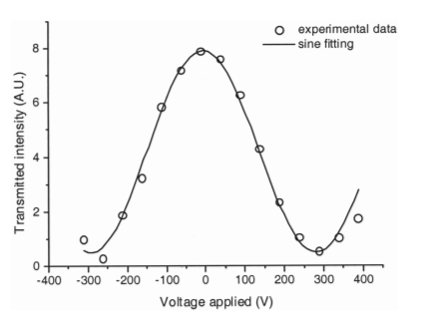
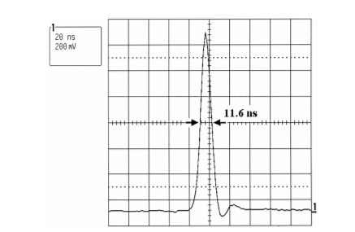
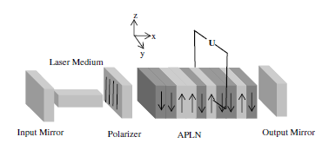
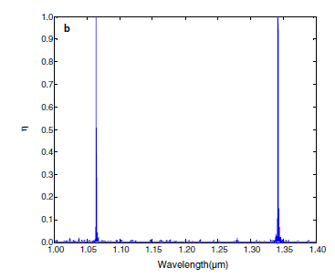
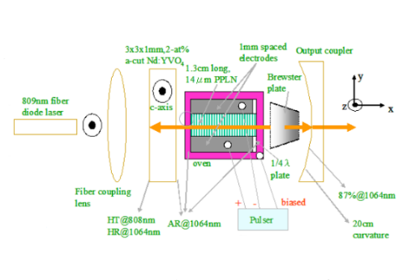
Motivation
Q-switch Lasers
Actively Q-switched Nd:YVO₄ laser using an electro-optic periodically poled lithium niobate crystal as a laser Q-switch
Theoretical study of the electro-optic effect of aperiodically poled lithium niobate in a Q-switched dual-wavelength laser
Chen, Y. H., and Y. C. Huang, Optics letters 28.16, p. 1460-1462, (2003)
Ji, Feng, et al, Optics communications 262.2, p. 234-237, (2006)
Notes:
1.陳彥宏博士等人首次成功的用一塊操作波長為1064nm週期性極化反轉鈮酸鋰晶體並利用電光偏振調制在特定的電場之間快速的切換來達到1064nm的脈衝雷射輸出。
2.延續著陳彥宏博士努力的研究，這群研究者用一塊操作波長在1064nm&1342nm的非週期性鈮酸鋰晶體並利用電光偏振調制在特定的電場之間快速的切換來達到雙波長同時輸出的脈衝雷射光輸出。

Slide 8
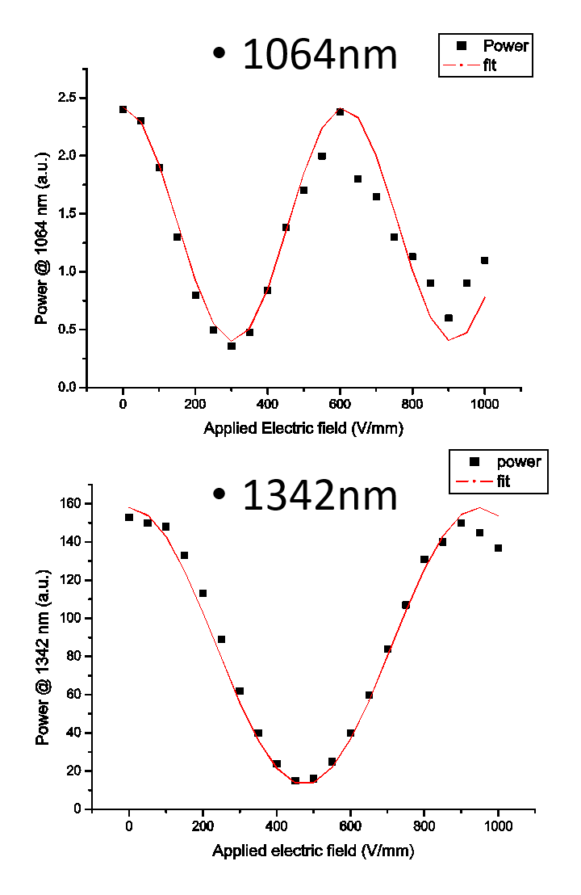
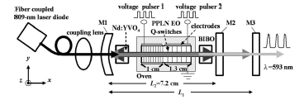
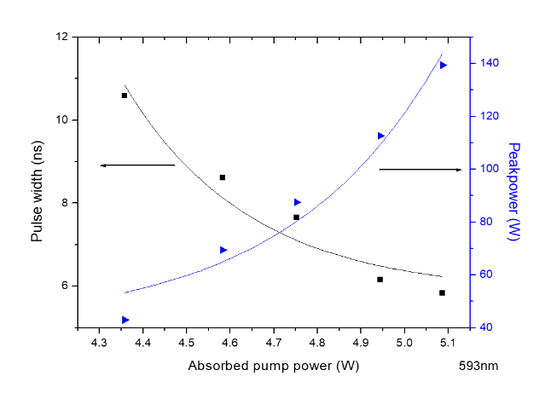
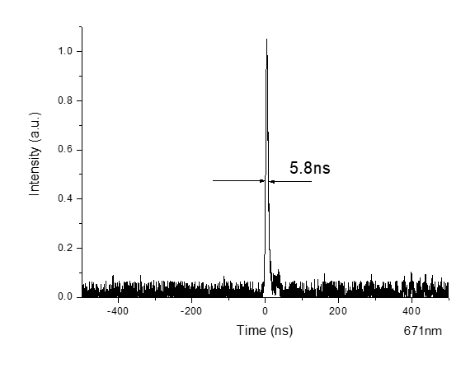
Motivation
Q-switch Lasers
Pulsed orange generation optimized in a diode-pumped Nd: YVO₄ laser using monolithic dual PPLN electro-optic Q switches
Chang, W. K., Y. H. Chen, and J. W. Chang, Optics letters 35.16, p. 2687-2689, (2010)
Notes:
1.本實驗室的張煒堃學長用一塊操作波長分別為1064與1342的串級式PPLN並利用兩段電光偏振調制，來達到分別Q調制1064與1342，最終分別輸出單一1064脈衝雷射與單一1342脈衝雷射光，並且在兩波長同時Q調制清況下利用鈮酸鋰晶體的和頻機制得到了操作波長為593的橘黃光脈衝光

Slide 9
Research ideas
CW 1064nm
CW 1342nm
Signal：1064nm&1342nm
Aperiodic optical superlattice
CW 1064nm&1342nm
Pulse 1064nm
Pulse 1342nm
Pulse 593nm

Slide 10
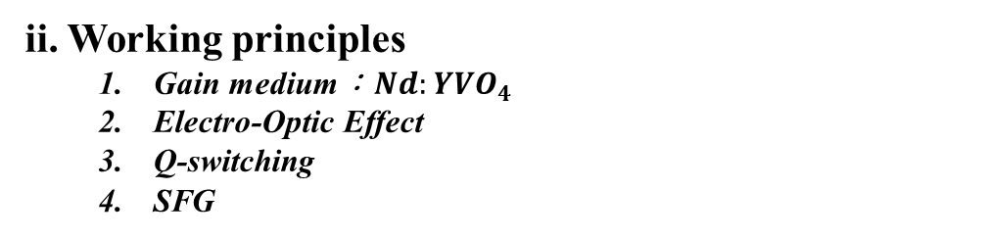
Outline
ii. Working principles
Gain medium：${Nd:YVO}_{4}$
Electro-Optic Effect
Q-switching
SFG

Slide 11
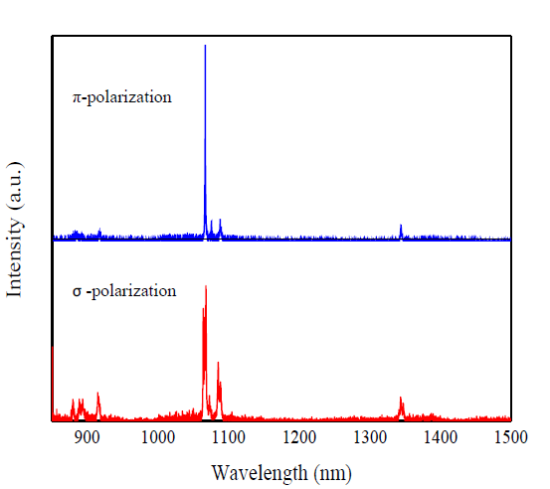





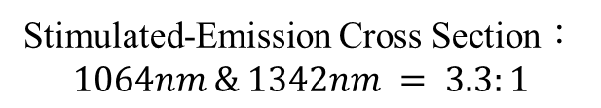
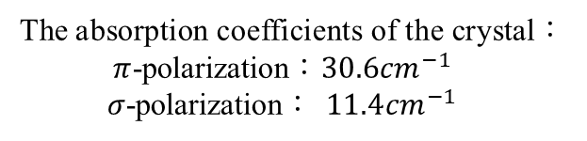
Gain medium：${Nd:YVO}_{4}$
Higher Gain
$π$-polarization
Lower Gain
The absorption coefficients of the crystal：
$π$-polarization：$30.6{cm}^{−1}$
$σ$-polarization： $11.4{cm}^{−1}$
c axis
$σ$-polarization
b axis
Incident light
a axis
Stimulated-Emission Cross Section：
$$1064nm \& 1342nm = 3.3:1$$
Nd:YVO₄ (a cut)
3 mm × 3 mm laser aperture and 7 mm length, a-cut, 0.5-at. % Nd³⁺ doping concentration.
Linear polarized > 237：1
TM
808nm pump
EO APPLN(2cm)
$$Nd:YVO_{4}$$
Mirror 2
張專慶，陳永富，「利用緊貼組合Nd:YAG 及Nd:YVO₄ 晶體 實現高效率雙波長946 nm 及1064 nm 雷射」，國立交通大學，碩士論文，民國101年。
Mirror 3
Notes:
光子密度
1064nm會搶到上能階大部分的粒子而增益輸出

Slide 12
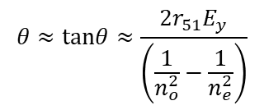

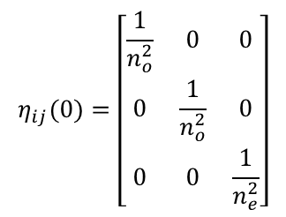




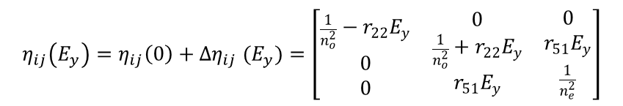
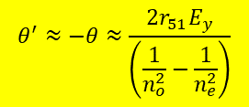

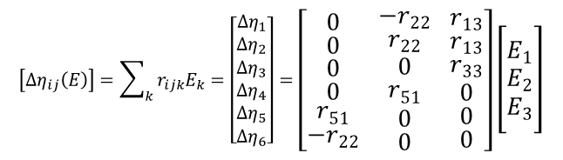
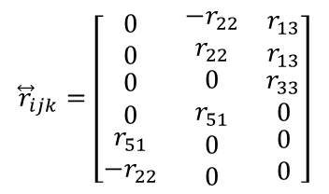
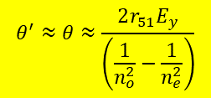
Electro-optic Effect
Electro-optic Effect in LiNbO₃
$$η_{ij}(0)=\left[\begin{matrix}\frac{1}{n_{o}^{2}} & 0 & 0 \\ 0 & \frac{1}{n_{o}^{2}} & 0 \\ 0 & 0 & \frac{1}{n_{e}^{2}}\end{matrix}\right]$$
$$θ≈tanθ≈\frac{2r_{51}E_{y}}{\left(\frac{1}{n_{o}^{2}}−\frac{1}{n_{e}^{2}}\right)}$$
$${\overset{⃡}{r}}_{ijk}=\left[\begin{matrix}\begin{matrix}0 \\ 0 \\ \begin{matrix}0 \\ 0 \\ \begin{matrix}r_{51} \\ −r_{22}\end{matrix}\end{matrix}\end{matrix} & \begin{matrix}−r_{22} \\ r_{22} \\ \begin{matrix}0 \\ r_{51} \\ \begin{matrix}0 \\ 0\end{matrix}\end{matrix}\end{matrix} & \begin{matrix}r_{13} \\ r_{13} \\ \begin{matrix}r_{33} \\ 0 \\ \begin{matrix}0 \\ 0\end{matrix}\end{matrix}\end{matrix}\end{matrix}\right]$$
$$\left(\begin{aligned}&y \\ &z\end{aligned}\right)=\left(\begin{aligned}&\begin{matrix}cosθ & −sinθ\end{matrix} \\ &\begin{matrix}sinθ & cosθ\end{matrix}\end{aligned}\right)\left(\begin{aligned}&y^{′} \\ &z^{′}\end{aligned}\right)$$
z
x
z
x
y
y
Impermeability tensor of negative uniaxial crystal
EO coefficient of LiNbO₃
V
V
$$\left[Δη_{ij}\left(E\right)\right]=\sum_{k}{r_{ijk}E_{k}}=\left[\begin{aligned}&\begin{matrix}∆η_{1} \\ ∆η_{2} \\ ∆η_{3}\end{matrix} \\ &∆η_{4} \\ &∆η_{5} \\ &∆η_{6}\end{aligned}\right]=\left[\begin{matrix}\begin{matrix}0 \\ 0 \\ \begin{matrix}0 \\ 0 \\ \begin{matrix}r_{51} \\ −r_{22}\end{matrix}\end{matrix}\end{matrix} & \begin{matrix}−r_{22} \\ r_{22} \\ \begin{matrix}0 \\ r_{51} \\ \begin{matrix}0 \\ 0\end{matrix}\end{matrix}\end{matrix} & \begin{matrix}r_{13} \\ r_{13} \\ \begin{matrix}r_{33} \\ 0 \\ \begin{matrix}0 \\ 0\end{matrix}\end{matrix}\end{matrix}\end{matrix}\right]\left[\begin{matrix}E_{1} \\ E_{2} \\ E_{3}\end{matrix}\right]$$
$$P_{s}$$
$$P_{s}$$
Difference of impermeability by apply electric field
$$η_{ij}\left(E_{y}\right)=η_{ij}\left(0\right)+∆η_{ij} (E_{y})=\left[\begin{matrix}\begin{matrix}\frac{1}{n_{o}^{2}}−r_{22}E_{y} \\ 0 \\ 0\end{matrix} & \begin{matrix}0 \\ \frac{1}{n_{o}^{2}}+r_{22}E_{y} \\ r_{51}E_{y}\end{matrix} & \begin{matrix}0 \\ r_{51}E_{y} \\ \frac{1}{n_{e}^{2}}\end{matrix}\end{matrix}\right]$$
$\frac{1}{2}λ$Plate
$\frac{1}{2}λ$Plate
$$θ^{′}≈θ≈\frac{2r_{51}E_{y}}{\left(\frac{1}{n_{o}^{2}}−\frac{1}{n_{e}^{2}}\right)}$$
$$θ^{′}≈−θ≈\frac{2r_{51}E_{y}}{\left(\frac{1}{n_{o}^{2}}−\frac{1}{n_{e}^{2}}\right)}$$
$$\left(\frac{1}{n_{o}^{2}}−r_{22}E_{y}\right)x^{2}+\left(\frac{1}{n_{o}^{2}}+r_{22}E_{y}\right)y^{2}+\frac{1}{n_{e}^{2}}z^{2}+2yzr_{51}E_{y}=1$$
Refractive index ellipsoid equation
Yariv & Yeh “Optical waves in crystals” chap.7, P.463, (2003)
Notes:
鈮酸鋰為電光晶體，本實驗利用施加Y方向電場的電光效應，鈮酸鋰晶體正晶疇r51為正，光軸旋轉角為負theta，鈮酸鋰晶體負晶疇r51為負，光軸選旋轉角為負theta
1.負單軸晶體不加電場的反介電張量
2.鈮酸鋰晶體電光係數
3.施加電場的反介電張量的變化量

Slide 13
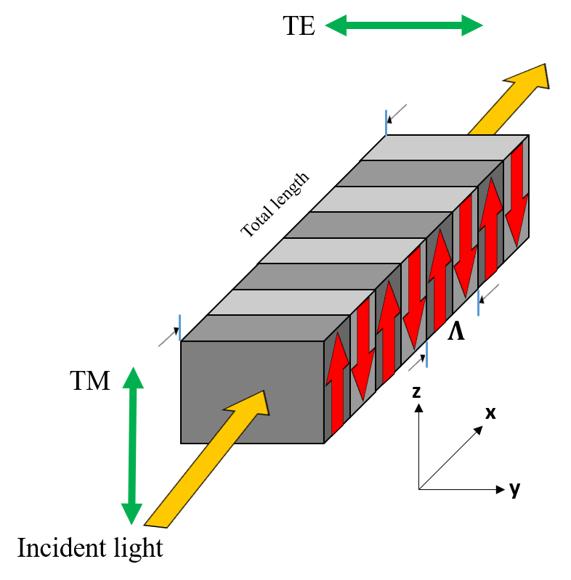
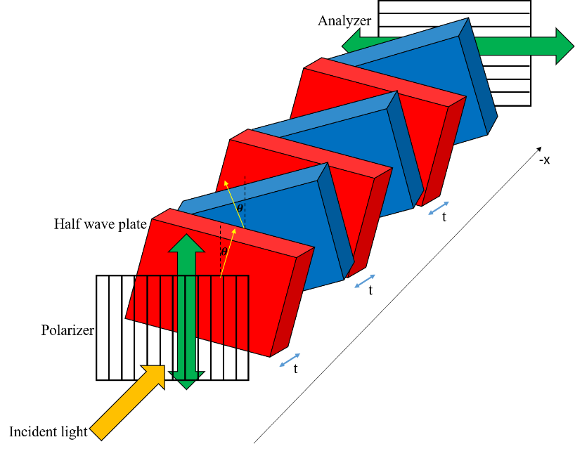
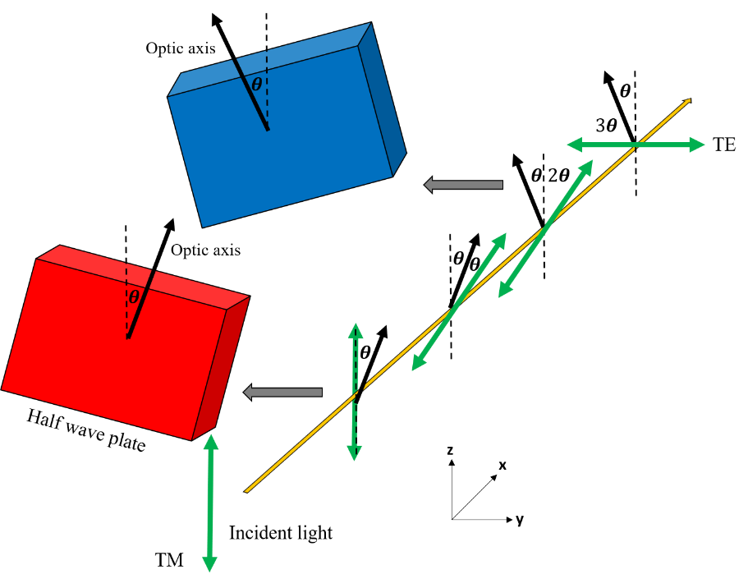
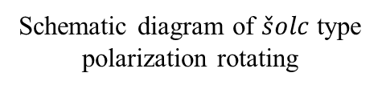













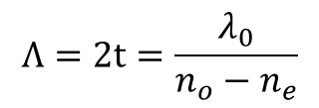

Electro-optic Effect
$\check{s}olc$ type filter in LiNbO₃
$\check{s}olc$ type filter in PPLN Crystal
Schematic diagram of $\check{s}olc$ type filter
Schematic diagram of $\check{s}olc$ type polarization rotating
$$z$$
V
$$Λ=2t=\frac{λ_{0}}{n_{o}−n_{e}}$$
$$−z^{′}$$
$$z^{′}$$
$t=\frac{2m+1}{2}\frac{λ_{0}}{n_{o}−n_{e}}$ ；m=1,2,3…
$$−θ$$
$$θ$$
$$−y$$
$$y$$
$$−y^{′}$$
$$y^{′}$$
$$x$$
Notes:
索爾克濾波器為兩種不同半波版交疊排列所組成，一種為…，一種為…，而工作原理為…….與原偏振差4theta以此排列下去，最終可將偏振旋轉成水平偏振，所而克濾波器好比於鈮酸李正副晶疇週期排列。

Slide 14
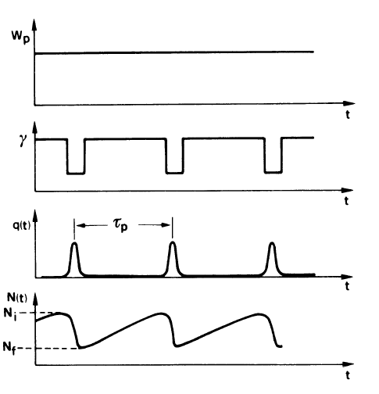
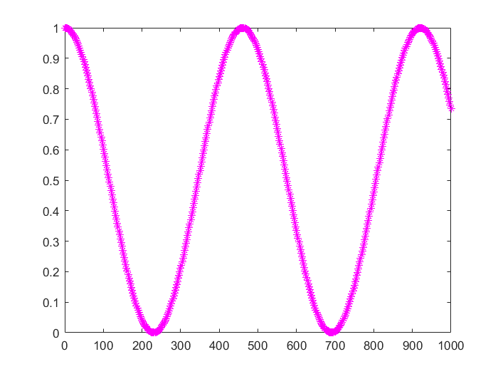

Q-switching
Pump band
Fast decay
Pulse Output
⁴F_{3/2}
$$∆τ_{p}$$
CW Output
808nm Pump
1342nm
1064nm
⁴F_{13/2}
⁴F_{11/2}
Ground
Transmittance(A.U.)
c axis
a axis
b axis
b axis
Incident light
a axis
Incident light
c axis
Nd:YVO₄ (a cut)
Nd:YVO₄ (c cut)
Electric field(V/mm)
3 mm × 3 mm laser aperture and 7 mm length, a-cut, 0.5-at. % Nd³⁺ doping concentration.

Slide 15
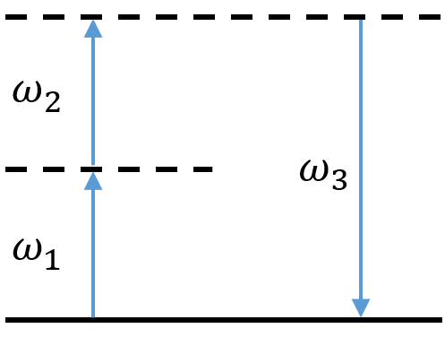




SFG
$$ω_{1}$$
$$ω_{3}$$
$$χ^{(2)}$$
$$ω_{2}$$
Conservation of momentum
$$E_{593.5nm}=E_{1064nm}+E_{1342nm}=h\left(ν_{1064nm}+ν_{1342nm}\right)=hν_{593.5nm}$$
Conservation of energy
$$\left.{\vec{k}}_{593.5nm}={\vec{k}}_{1064nm}+{\vec{k}}_{1342nm}=2π(\frac{n_{1064nm}}{λ_{1064nm}})+2π(\frac{n_{1342nm}}{λ_{1342nm}})=2π(\frac{n_{593.5nm}}{λ_{593.5nm}}\right)$$

Slide 16
Outline
iii. Device Design and Simulation Results
Simulated Annealing Method
Dual-wavelength Electro-Optic polarization rotation
Simulation Results

Slide 17
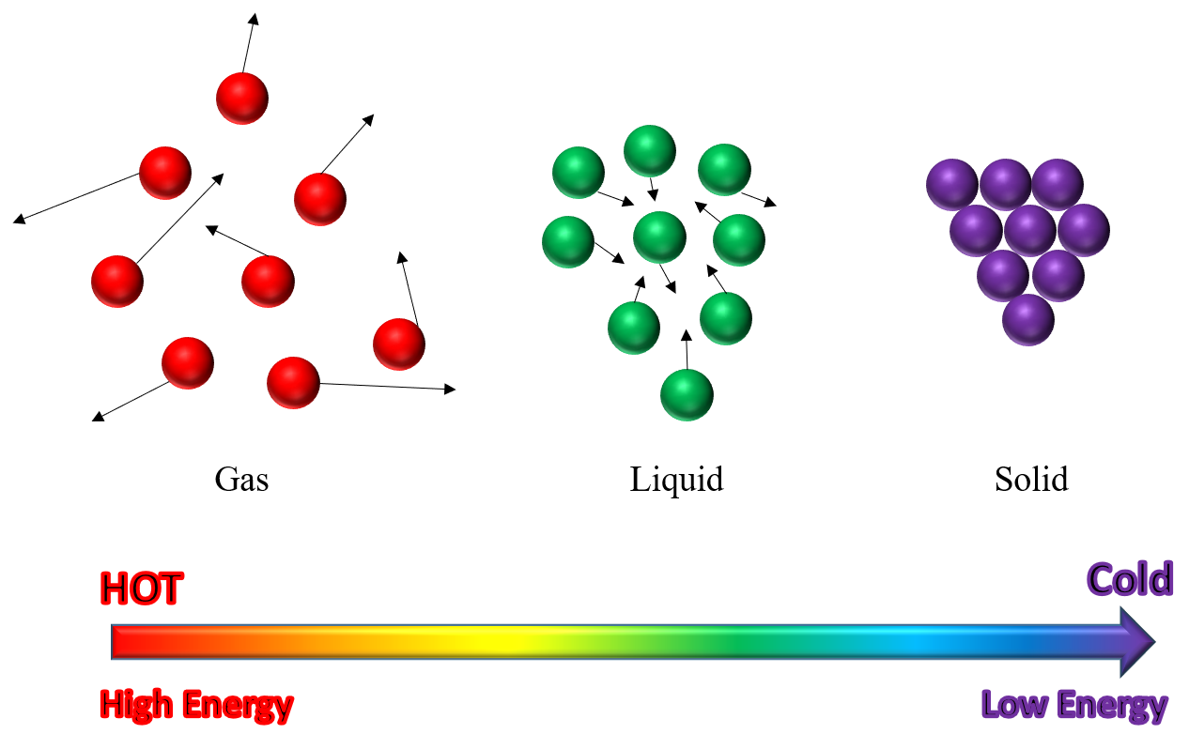
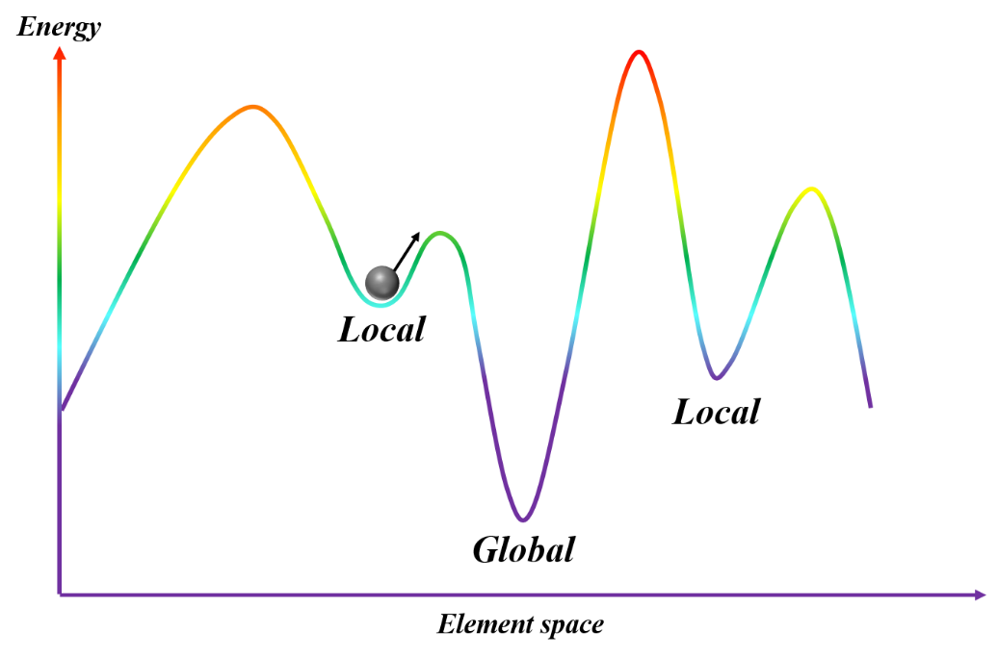













Simulated Annealing Method
Set the initial condition：Domain number=N,
Domain(j), j=0
Set the object Function(OF) Calculation, OF(0)
Set the parameter of annealing：$T_{in}$、$T_{re}$、$T_{final}$
$$domain\left(j\right)=−1×domain(j)$$
No
$$j=j+1$$
Yes
$OF\left(j\right)<OF(j−1)$
$ρ<e^{−{C_{p}}/T}$
$$ρ(T)<e^{\left(−\frac{C_{p}}{T}\right)}$$
$$j=1$$
$$domain\left(j\right)=−1×domain(j)$$
$$OF\left(0\right)=OF(j)$$
No
$$j>N$$
$$Calculate Objective Function(j)$$
Yes
$$T=T×T_{re}$$
No
$$domain change?$$
Yes
No
$$T≤T_{final}$$
Yes
end

Slide 18










Simulated Annealing Method
Device design parameters
Crystal length：2cm
Phase matching temperature ：40℃
Signal wavelength：1064nm & 1342nm
Object function target value：
$A_{e,λ_{1064},Target value}\left(90V/mm\right)=0.5974$
$A_{e,λ_{1342},Target value}\left(90V/mm\right)=0.1235$
1mm
Objective Function
$$OF=\sum_{j=1}^{N}{wi\left(A_{e,λ_{1064},Target value}\left(E_{y}\right)−A_{e, λ_{1064}, Actual value}\left(E_{y}\right)\right)+wi\left(A_{e,λ_{1342},Target value}\left(E_{y}\right)−A_{e, λ_{1342}, Actual value}\left(E_{y}\right)\right)}$$
2cm
$$+β\left\{max\left[A_{e, λ_{1064}, Actual value}\left(E_{y}\right),A_{e, λ_{1342}, Actual value}\left(E_{y}\right)\right]−min\left[A_{e, λ_{1064}, Actual value}\left(E_{y}\right),A_{e, λ_{1342}, Actual value}\left(E_{y}\right)\right]\right\}$$
Initial value
$$A_{e,λ_{1064}}(0)$$
Actual value
$$A_{e,λ_{1064}}(E_{y})$$
Target value
$$A_{e,λ_{1064}}(E_{y})$$
Initial value
$$A_{e,λ_{1342}}(0)$$
Actual value
$$A_{e,λ_{1342}}(E_{y})$$
Target value
$$A_{e,λ_{1342}}(E_{y})$$
Notes:
TM偏振穿透率對電場進行SIN波振盪

Slide 19






Simulated Annealing Method
Device design result
1064.50nm
1342.33nm
Transmittance(A.U.)
Transmittance(A.U.)
TM polarization-Transmittance(A.U.)
Wavelength(nm)
Wavelength(nm)
Electric field(V/mm)
1064.50nm
1342.33nm
Transmittance(A.U.)
Transmittance(A.U.)
TM polarization-Transmittance(A.U.)
Wavelength(nm)
Wavelength(nm)
233V/mm
822V/mm
Electric field(V/mm)

Slide 20




Round trip calculation
Round Trip
808nm Laser
$$Nd:YVO_{4}$$
EO APPLN($2cm×1mm$)
Round Trip + Single pass
808nm Laser
$$Nd:YVO_{4}$$
EO APPLN($2cm×1mm$)

Slide 21
Outline
iv. Device Fabrication
Fabrication process of EO APPLN

Slide 22







Fabrication process of EO APPLN
Soft baking
clean wafer
Photoresist coating
Schematic diagram of positive photomask
Schematic diagram of ${LiNbO}_{3}$ chip after lithography
Hard baking
Development
Exposure

Slide 23






Fabrication process of EO APPLN
Poling fixture
Inject $LiCl$ in poling fixture
${LiNbO}_{3}$ after poling and etching
Applied high electric field

Slide 24



Dicing, Polishing, Coating
Polishing
Coating
Diagram of the EOAPPLN after endface polishing
Diagram of the EOAPPLN after coating
Completed product

Slide 25
Outline
v. Experimental Setup and Results Analysis
Single pass measurement
CW operation
Q-switched operation

Slide 26








Single pass measurement
Power meter
I:7.0A
V:23.2V
$${?.???}_{mW}$$
OK
$$λ {1064}_{nm}$$
Unit
$$System Menu$$
$$Meas View$$
$$λ$$
$$Δ$$
T
C
on
POWER SUPPLY
LIMQ laser system
Iris
Pump laser:
809nm diode laser
$$Nd:YVO_{4}$$
f=75mm
f=125mm
PBS
Mirror 1
Mirror 2,3
EO APPLN($2cm×1mm$)
HR@808nm filter
EO-APPLN($2cm×1mm$)
Plastic screw
Acrylic
Temperature Controller
Mirror 1: Meniscus mirror; ROC=15 cm T~93%@809 nm, HR~99.8%@1064 nm, HR~99.8%@1342 nm
brass
Temperature sensor
Mirror 2: Plane mirror; HR~99.908%@1342 nm HT~96.256%@1064nm
Teflon
Mirror 3: Plane mirror; HR~61.3%@1064 nm HT~99.3%@1342nm
Heater

Slide 27



Single pass measurement
No poling error
Poling error effect
Under-poled
Under-poled
Under-poled
Extra-cavity single pass measurement
Under-poled：$3\sim 4μm$
Simulation EO coefficient：
26pm/V
Fitting EO coefficient：
24pm/V
Poling error effect
Simulation Temperature：
40℃
Fitting Temperature：
40.2℃

Slide 28



CW operation
OSA
I:7.0A
V:23.2V
ANRITSU
MS9740A
Level
Preset
$$f1$$
$$Log$$
$$Ref$$
$$VBW$$
$$f2$$
Peak
$$1$$
$$2$$
$$3$$
T
C
POWER SUPPLY
$$f3$$
$$Center$$
$$Ref Lv1$$
$$SAVE$$
$$f4$$
Marker
$$4$$
$$5$$
$$6$$
$$Recall$$
$$f5$$
$$Marker$$
Select
$$Zone$$
Marker
$$Peak$$
Search
$$7$$
$$8$$
$$9$$
on
$$Copy$$
$$f6$$
Sweep
$$0$$
$$.$$
$$−$$
Power
$$f7$$
$$Single$$
$$Repeat$$
$$Stop$$
$$BS$$
$$Enter$$
$$Cancel$$
$$F1$$
$$F2$$
$$F3$$
$$F4$$
$$F5$$
$$F6$$
$$F7$$
12cm
7.4cm
LIMQ laser system
Fiber Coupled
809nm laser diode
EO APPLN(2cm)
$$Nd:YVO_{4}$$
Mirror 1
Mirror 2
Mirror 3
Mirror 1: Meniscus mirror; ROC=15 cm T~93%@809 nm, HR~99.8%@1064 nm, HR~99.8%@1342 nm
HR@808nm filter
Mirror 2: Plane mirror; HR~99.908%@1342 nm HT~96.256%@1064nm
Mirror 3: Plane mirror; HR~61.3%@1064 nm HT~99.3%@1342nm

Slide 29




CW operation
0V/mm
267V/mm
685V/mm
895V/mm

Slide 30






CW operation
243V/mm
255V/mm
267V/mm
1064.5nm Tolerance：42V/mm
244V/mm
285V/mm
1064.50nm
1342.33nm
TM polarization-Transmittance(A.U.)
275V/mm
286V/mm
0.02714
Electric field(V/mm)

Slide 31





CW operation
883V/mm
891V/mm
895V/mm
1342.33nm Tolerance：33V/mm
884V/mm
916V/mm
1064.50nm
1342.33nm
TM polarization-Transmittance(A.U.)
907V/mm
917V/mm
0.04875
31
Electric field(V/mm)

Slide 32

Q-switched operation
1
2
POWER SUPPLY
POWER SUPPLY
Oscilloscope
I:7.0A
V:23.2V
T
C
CH 1
LOCAL
2
STOP
1
5
3
pulser
→
4
6
ENTER
on
←
7
8
9
menu
.
$$+/−$$
0
CH 2
12cm
7.4cm
LIMQ laser system
Fiber Coupled
809nm laser diode
EO APPLN(2cm)
$$Nd:YVO_{4}$$
Mirror 1
Mirror 2
Mirror 3
Mirror 1: Meniscus mirror; ROC=15 cm T~93%@809 nm, HR~99.8%@1064 nm, HR~99.8%@1342 nm
Mirror 2: Plane mirror; HR~99.908%@1342 nm HT~96.256%@1064nm
HR@808nm filter
Mirror 3: Plane mirror; HR~61.3%@1064 nm HT~99.3%@1342nm
Notes:
正行方波電壓脈衝訊號，正端為上升後的電壓，也就是HIGH-Q電壓另一台接負端作為偏壓電源，提申至特定的直流準位，GROUND提升至LOWQ電壓。
負方波電壓脈衝訊號，負端坐為下降後的電壓，也就是HIGH-Q電壓另一台接正端作為偏壓電源，，提申至特定的直流準位，GROUND提升至LOWQ電壓。

Slide 33





Q-switched operation
685V
685V
685V
685V
685V
POWER SUPPLY
POWER SUPPLY
2
1
255V
261V
267V
269V
273V
1064nm Pulse width
CH 1
pulser
1064.50nm
1064nm
1342.33nm
532nm Pulse width
Transmittance(A.U.)
Electric field(V/mm)
532nm

Slide 34





Q-switched operation
875V
875V
895V
897V
901V
685V
680V
685V
685V
685V
POWER SUPPLY
POWER SUPPLY
2
1
1342nm Pulse width
pulser
CH 2
1064.50nm
1342nm
1342.33nm
671nm Pulse width
Transmittance(A.U.)
Electric field(V/mm)
671nm

Slide 35


Q-switched operation
POWER SUPPLY
POWER SUPPLY
2
1
CH 1
685V
685V
685V
685V
685V
pulser
0V
0V
0V
2V
3V
593nm Pulse width
1064.50nm
1342.33nm
Transmittance(A.U.)
593nm
Electric field(V/mm)

Slide 36
Outline
vi. Conclusions and Future work

Slide 37

Conclusions
We use the simulated annealing method to calculate an aperiodically poled lithium niobite device for achieving a novel electro-optically laser-line switchable dual-wavelength cw/Q-switched Nd:YVO₄ laser
We successfully achieved wavelength selection via EO tuning in a cw dual-wavelength 1064.5nm and 1342.33nm laser with electric field tuning tolerances of ~42V/mm and ~33V/mm, respectively.
When the system is operated at a repetition rate of 1kHz and a pump power of ~7.014W, we can obtain pulsed 1064 nm, 1342 nm, 593 nm orange, 532 nm green, and 671 nm red generations simply by EO tuning:
Wavelength | Pulse width | Peak power | Applied electric field
1064nm | 9.6140ns | 18.5kW | 267V/mm $↔$ 685V/mm
532nm (non-phase matching) | 8.7368ns | 30.79W
1342nm | 25.4740ns | 13.8kW | 685V/mm $↔$ 895V/mm
671nm (non-phase matching) | 15.0374ns | 9.71W
593nm (non-phase matching) | 8.0198ns | 74.19W | 0V/mm $↔$ 685V/mm

Slide 38






Future work
6nm
1047nm
1053nm
c axis
b axis
Transmittance(A.U.)
Transmittance(A.U.)
Incident light
a axis
Nd:YLF (a cut)
Wavelength(nm)
Wavelength(nm)
1047nm
1053nm
Transmittance(A.U.)
Transmittance(A.U.)
Transmittance(A.U.)
Wavelength(nm)
Wavelength(nm)
230V/mm
372V/mm
Electric field(V/mm)
李瑋倫、陳永富，摻釹氟化釔鋰晶體在連續波與被動式 Q 開關雷射之研究。Diss, (2010)

Slide 39


Thank you for your attention!

Slide 40





16A
17A
18A
16A
1064.549nm
17A
1064.547nm
18A
1064.539nm
0.031nm
19A
1064.529nm
19A
20A
20A
1064.518nm

Slide 41

1064.469nm
1064.500nm
1064.500nm
1342.33nm
0.031nm
TM polarization-Transmittance(A.U.)
1064.469nm
Electric field(V/mm)

Slide 42


$$Nd:YVO_{4}$$
Mirror 1
Mirror 2
Loss↑
$$Nd:YVO_{4}$$
Mirror 1
Mirror 2

